Slide 1




4 – Merge Conflicts
https://www.youtube.com/watch?v=Tyd0FO0tko8
Images from:
https://git-scm.com/downloads/logos
https://github.com/logos
Notes:
BEFORE CLASS:
- Need to merge the conflict branch right before class.
- This branch will change all of the lines that are touched by the round2 issues.
- That will change everyone’s PR from
- can be merged automatically
- to contains conflicts.
In the activity due today you
-addressed another issue
- adding a link to the README
- made a pull request for that change to the upstream.
Today we’ll do a quick overview of how you got there.
Then we will see
- What can happen when multiple changes conflict.
- We have been careful to this point to ensure that each change was independent.
- So your change did not affect anyone else's
- And theirs did not affect yours.
- But clearly with multiple people working asynchronously in a distributed community
- it is possible that concurrent changes
- by different people
- will interact in was that conflict.
- When we try to bring those changes together
- They create what is called a merge conflict.

Slide 2
Our Current State
How did we
get here?
commit
Pull Request
Synch
switch
branch
push
stage
Edit
Notes:
This is where things stand after you have completed the prior homework.
How did we get here?
- Discuss with your neighbors…
- Place this list of terms into a plausible order.
Build the list on the board:
1. Synch
2. branch
3. switch
4. Edit
5. stage
6. commit
7. push
8. Pull request
Note that all developers might be doing the same thing.

Slide 3
Our Current State
Demo: Look at the Pull Requests on GitHub
Notes:
This is where you were when you made your PR.
- When you finished the previous homework your PR should have said
- can be merged automatically.
- From this picture that should make sense
- your blue commit (and the fuchsia and lime ones too)
- all can be applied directly on the green one
- which is still at the head of the main branch.
But if we look at your PR’s now…
- They will say “This branch has conflicts that must be resolved”
- Show a few of their PR’s from the upstream repo to illustrate this.
Why/How did that happen?
- next slide.

Slide 4
Upstream Changes
✓
Why could there be a conflict
now?
Notes:
This is the state of the world now…
- What has happened?
- Maintainers (me) merged a pull request into main
- the Fuchsia commit was added.
Ask: Why do you think it created conflict?
- Just get at the idea that the blue (or lime) commit
- must have changed the same parts of the repo
- i.e. the same area of a file.
- Don’t need to be too precise here.
Truth:
- I merged a commit that changed
- all four lines that were affected by the round 2 issues.
- so that commit will create a merge conflict for everyone

Slide 5
Merging Changes
A merge
operation combines the changes in the
source branches into a
merge commit
and adds it to the target branch.
Time
main
Merge
Commit
featureBranch
5
5
Notes:
Here we have a pull request asking to merging the changes that have been made in the featureBranch with the changes that have been made in the main branch.
A merge is an operation that
- combines the changes in the source branches
- into a new commit called a merge commit
- and adds that commit to the target branch.
What are the source branches here?
- main and featureBranch
- these are the branches that contain the changes that are to be merged.
What is the target branch?
- main
- this is the branch where the new merge commit containing the merged changes is to be added.
The merge commit combines the changes from
- the fuchsia commit and the blue commit into a new commit (the merge commit)
- the merge commit is applied to main after the fuchsia commit.
- the fuchsia ring around the merge commit represents that this commit combines the blue and fuchsia commits.
Having a merge commit makes it clear where the changes came from.
- part of the history.
- preserves the fact that a branch was merged
- where the branch came from
- what commits it contained
- when it was merged
- who merged it.
NOTE:
- This skirts the issue of what happens when there are multiple commits on the feature branch.
- What we show here is a “squash and merge”
- Squash and merge, compresses all commits in the feature branch into a single merge commit.
- This is a common strategy for keeping project history simple.
- Different project and different organizations will use different approaches in the case where there are multiple commits in the feature branch being merged, but that is beyond the scope of this activity.

Slide 6
Merge: Common Ancestors
The Best Common Ancestor
is often the most recent common ancestor
A Common Ancestor is a commit that exists in both histories.
Old MacDonald had a farm
And on that farm, he had a chicken
With a cluck cluck here
And a cluck cluck there
Old MacDonald had a farm
And on that farm, he had a duck
With a quack quack here
And a quack quack there
Old MacDonald had a farm
And on that farm, he had a cow
With a moo moo here
And a moo moo there
Old MacDonald had a farm
And on that farm, he had a duck
With a quack quack here
And a quack quack there
Old MacDonald had a farm
And on that farm, he had a cow
With a moo moo here
And a moo moo there
Old MacDonald had a farm
And on that farm, he had a goat
With a bahh bahh here
And a bahh bahh there
Feature Branch
Best Common Ancestor
main Branch
Notes:
Let’s have a little closer look at the merge process
- to understand why there were no conflicts with your Round 1 issues
- why there are conflicts with your Round 2 issues.
- this will give us a foundation for understanding how we resolve merge conflicts.
Here the maintainers want to merge the changes in the source branches:
- the feature branch – blue commit
- the main branch – fuchsia commit
Into the target branch
- main.
The way this works is that git uses the history to identify the best common ancestor that is shared by the two branches being merged.
- A common ancestor is a commit that exists in the history of the source branches that are being merged.
- What are the common ancestors here?
- The history of both the feature branch and the main branch contain the Red, Yellow, and Green commits.
- So those are the common ancestors.
- Which ancestor is the best common ancestor is determined by git and is somewhat complex.
- The details of how it works are beyond the scope of these materials.
- You can find it documented elsewhere if you are interested.
- In most typical use cases the best common ancestor will be the most recent common ancestor.
- What is the best common ancestor here?
- The Green commit is the newest commit that that is shared by the history of the source branches.
- So, it is the “best common ancestor”
Here in the best common ancestor Old MacDonald had
- a cow and a goat.
- both the feature branch and the main branch have made changes.
Note: Old MacDonald is a children’s song that is popular in the United States. It is sung to help children learn animal names and sounds. The details of the song are not important to this example, just changes between the branches!

Slide 7
Merge: Identifying Changes
Git identifies changes relative to the best common ancestor.
What changes have occurred in the feature and main branches?
Old MacDonald had a farm
And on that farm, he had a chicken
With a cluck cluck here
And a cluck cluck there
Old MacDonald had a farm
And on that farm, he had a duck
With a quack quack here
And a quack quack there
Old MacDonald had a farm
And on that farm, he had a cow
With a moo moo here
And a moo moo there
Old MacDonald had a farm
And on that farm, he had a duck
With a quack quack here
And a quack quack there
Old MacDonald had a farm
And on that farm, he had a cow
With a moo moo here
And a moo moo there
Old MacDonald had a farm
And on that farm, he had a goat
With a bahh bahh here
And a bahh bahh there
Feature Branch
Best Common Ancestor
main Branch
Notes:
Next
- git will compare the branches being merged to the best common ancestor
- and identify the changes that have occurred in each of the branches involved in the merge.
What changes do you see?

Slide 8
Merge: Non-Conflicting Changes
Non-conflicting changes can be merged automatically.
These are
non-conflicting
changes.
Old MacDonald had a farm
And on that farm, he had a chicken
With a cluck cluck here
And a cluck cluck there
Old MacDonald had a farm
And on that farm, he had a duck
With a quack quack here
And a quack quack there
Old MacDonald had a farm
And on that farm, he had a cow
With a moo moo here
And a moo moo there
Old MacDonald had a farm
And on that farm, he had a duck
With a quack quack here
And a quack quack there
Old MacDonald had a farm
And on that farm, he had a cow
With a moo moo here
And a moo moo there
Old MacDonald had a farm
And on that farm, he had a goat
With a bahh bahh here
And a bahh bahh there
Feature Branch
Best Common Ancestor
main Branch
Notes:
The lines in the source branches that contain changes relative to the best common ancestor are highlighted in blue.
- The changes in the feature branch as compared to the common ancestor are cow and moo were changed to chicken and cluck
- The changes in the main branch as compared to the common ancestor are duck and quack were changed to goat and bahh
Ask:
- What makes these non-conflicting changes?
- They do not affect the same lines of the file.
Ask:
- What would make changes conflicting?
- If both the feature and main branches had made changes to the same line.
- For example:
- if the feature branch (blue commit) had changed duck or quack.
- and/or if main (fuchsia commit) had changed cow or moo
- and/or they had both changed one of the other lines.
The idea of conflicting and non-conflicting changes is
- intuitively simple
- roughly…
- If the source branches do not change the same line the changes are not conflicting.
- if the source branches change the same line then they are conflicting.
- In practice, it is more clever and sophisticated than that…
- the details of the algorithm that git uses is beyond the scope of these activities.
- so for our purposes we will assume the above ”line-based” approach to determining if changes are conflicting or not.
Non-conflicting changes can be merged automatically.
- There is no confusion about what change to pick, because there is no conflict.
- Thus git can perform this merge for us.
- The managers of the upstream will do this
- It is what we saw happen with your PR’s for your Round 1 issues.
- Everyone’s PR changed a different line, so none of them conflicted.
- Thus, they could call be merged automatically.

Slide 9
Merge: Non-Conflicting Changes
Time
The Merge Result is created automatically by git by applying all Non-conflicting changes to the best common ancestor.
main
hadChicken
Merge Result
Old MacDonald had a farm
And on that farm, he had a chicken
With a cluck cluck here
And a cluck cluck there
Old MacDonald had a farm
And on that farm, he had a duck
With a quack quack here
And a quack quack there
Old MacDonald had a farm
And on that farm, he had a chicken
With a cluck cluck here
And a cluck cluck there
Old MacDonald had a farm
And on that farm, he had a goat
With a bahh bahh here
And a bahh bahh there
Old MacDonald had a farm
And on that farm, he had a cow
With a moo moo here
And a moo moo there
Old MacDonald had a farm
And on that farm, he had a goat
With a bahh bahh here
And a bahh bahh there
9
Feature Branch
main Branch
9
Notes:
Notice that this slide is showing the “Result”
- The result is created by applying all of the non-conflicting changes from the source branches to the best common ancestor.
Recall that in the best common ancestor OldMacDonald had a cow and a duck.
- So, the result here applies
- The change from cow -> chicken from the feature branch.
- The change from duck -> goat from the main branch.
- The result of this is shown in the Merge Result box (center)
The Merge Result shows the status of the main branch after the merge commit is added.
- So, after the merge OldMacdonald in the main branch has a chicken and a goat.
Notice that here the ring around the merge commit is white
- It does not have the fuchsia ring around it as on the earlier slide
- That fuchsia ring represented a blending of the changes from the two commits.
- In this case all of the non-conflicting changes from the fuchsia commit are already in main
- Thus, the only changes in the merge commit will be those from the blue commit.
- Thus, no fuchsia ring in this diagram!
This is what happened as each of your Round 1 issues were merged.

Slide 10
Merge: Identifying Changes 2
Time
What changes have occurred here?
main
hadPig
Old MacDonald had a farm
And on that farm, he had a chicken
With a cluck cluck here
And a cluck cluck there
Old MacDonald had a farm
And on that farm, he had a pig
With a oink oink here
And a oink oink there
Old MacDonald had a farm
And on that farm, he had a chicken
With a cluck cluck here
And a cluck cluck there
Old MacDonald had a farm
And on that farm, he had a goat
With a bahh bahh here
And a bahh bahh there
Old MacDonald had a farm
And on that farm, he had a chicken
With a buk buk here
And a buk buk there
Old MacDonald had a farm
And on that farm, he had a piglet
With an oinky oink here
And an oinky oink there
Feature Branch
Best Common Ancestor
Main Branch
Notes:
What changes have occurred here?
- In the feature branch “goat” and “bahh bahh” have changed to “pig” and “oink oink”
- In the main branch “goat” and “a bahh bahh” have changed to “piglet” and “an oinky oink”
- piglets make a cuter noise than pigs ;)
- Also note that in main the chicken sound has been changed to buk buk

Slide 11
Merge: Conflicting Changes
Conflicting changes occur when source branches change the same lines.
Time
main
hadPig
Old MacDonald had a farm
And on that farm, he had a chicken
With a cluck cluck here
And a cluck cluck there
Old MacDonald had a farm
And on that farm, he had a pig
With a oink oink here
And a oink oink there
Old MacDonald had a farm
And on that farm, he had a chicken
With a cluck cluck here
And a cluck cluck there
Old MacDonald had a farm
And on that farm, he had a goat
With a bahh bahh here
And a bahh bahh there
Old MacDonald had a farm
And on that farm, he had a chicken
With a buk buk here
And a buk buk there
Old MacDonald had a farm
And on that farm, he had a piglet
With an oinky oink here
And an oinky oink there
Feature Branch
Best Common Ancestor
Main Branch
Notes:
Changes in the source branches with respect to the best common ancestor are shown with highlighting
- Non-conflicting changes in main are highlighted in blue.
- The conflicting changes are highlighted in red.
- When both source branches change the same line it creates conflicting changes.
A merge conflict occurs when:
- There is no way for git to know what the intended result is.
- should it be a pig or a piglet?
- should it be a oinky oink or an oink oink or an oinky oink?
- We may know
- but there is no way for git to know.
- the right choice depends on meaning.
- So this type of conflict must be resolved manually.
Now the project managers could take the time to do this…
- But
- they are busy people
- and you are the expert on the changes you are adding
- So
- usually you will be asked to fix this.
- That is also compatible with the idea that
- The current main branch should be the starting point for all new work.
- Basically, it is your responsibility to ensure that your changes are compatible with the current state of the main branch.
So what do you do?
- Synch and merge the changes in main into your feature branch.

Slide 12
Merge: Merge Conflicts
Merge Conflicts
must be resolved manually.
Conflicting changes result in
merge conflicts
Merge Result
Old MacDonald had a farm
And on that farm, he had a chicken
With a cluck cluck here
And a cluck cluck there
Old MacDonald had a farm
And on that farm, he had a pig
With a oink oink here
And a oink oink there
Old MacDonald had a farm
And on that farm, he had a chicken
With a buk buk here
And a buk buk there
Old MacDonald had a farm
And on that farm, he had a pig
With an oink oink here
And an oink oink there
Old MacDonald had a farm
And on that farm, he had a chicken
With a buk buk here
And a buk buk there
Old MacDonald had a farm
And on that farm, he had a piglet
With an oinky oink here
And an oinky oink there
Feature Branch
Main Branch
Notes:
Notice that this slide is showing the “Result”
- The result is created by applying all of the non-conflicting changes from the source branches to the best common ancestor
- and by resolving any conflicting changes into the merge result.
A merge conflict occurs when:
- Two source branches that contain conflicting changes are merged.
Merge Conflicts must be resolved manually by a developer.
- This is because there is no way for git to know what the intended result is.
- should it be a pig or a piglet?
- should it be a oinky oink or an oink oink or an oinky oink or something else?
- We may know
- but there is no way for git to know.
- the right choice depends on meaning.
- Thus, this type of conflict must be resolved manually.
Non-conflicting changes there is no doubt…
- Change the chicken to go buk buk.

Slide 13
Practice: Identifying Changes
Highlight the non-conflicting changes in blue and the conflicting changes in red.
x = [ 1, 5, 3, 9, 2 ]
max = x[0]
for n in x:
if n >= max:
max = n
print max
x = [ 1, 5, 3, 9, 2 ]
m = x[0]
for n in x:
if n >= m:
m = n
print m
x = [ 1, 5, 3, 9, 2 ]
m = x[0]
for n in range(1:length(x)):
if x[n] > m:
m = x[n]
print m
Feature Branch
Best Common Ancestor
Main Branch
Notes:
For practice:
- Consider this small python program…
- What is it trying to do?
The feature branch includes changes that improve the readability of the code.
- It uses max instead of m, making it more clear what is happening.
The main branch includes changes that improve the performance of the code.
- It does not look at the 0th item twice.
- it does not change m if the values of x[n] and m are equal.
Using these branches and the given best common ancestor
- highlight all of the non-conflicting changes in blue.
- highlight all of the conflicting changes in red.
One good approach:
- Consider the feature branch first…
- in the feature branch, highlight in blue all of the differences as compared to the best common ancestor.
- Don’t worry if they are conflicting or not yet.
- Then consider the main branch
- in the main branch, highlight in blue all of the differences as compared to the best common ancestor.
- Still, don’t worry if they are conflicting or not yet
- Then look at the feature and main branches to identify any conflicting changes
- lines that have changed in both the feature branch and the main branch are conflicting changes
- change their highlight to red in both the feature branch and the main branch.

Slide 14
Practice: Identifying Changes
Highlight the non-conflicting changes in blue and the conflicting changes in red.
x = [ 1, 5, 3, 9, 2 ]
max = x[0]
for n in x:
if n >= max:
max = n
print max
x = [ 1, 5, 3, 9, 2 ]
m = x[0]
for n in x:
if n >= m:
m = n
print m
x = [ 1, 5, 3, 9, 2 ]
m = x[0]
for n in range(1:length(x)):
if x[n] > m:
m = x[n]
print m
Feature Branch
Best Common Ancestor
Main Branch

Slide 15
Practice: Merge
Merge the feature branch and the main branch. Resolve the conflicts so that the program will work with the non-conflicting changes.
Merge Result
x = [ 1, 5, 3, 9, 2 ]
max = x[0]
for n in x:
if n >= max:
max = n
print max
x = [ 1, 5, 3, 9, 2 ]
m = x[0]
for n in range(1:length(x)):
if x[n] > m:
m = x[n]
print m
Feature Branch
main Branch

Slide 16
Practice: Merge
Merge the feature branch and the main branch. Resolve the conflicts so that the program will work with the non-conflicting changes.
Merge Result
x = [ 1, 5, 3, 9, 2 ]
max = x[0]
for n in x:
if n >= max:
max = n
print max
x = [ 1, 5, 3, 9, 2 ]
max = x[0]
for n in range(1:length(x)):
if x[n] > max:
max = x[n]
print max
x = [ 1, 5, 3, 9, 2 ]
m = x[0]
for n in range(1:length(x)):
if x[n] > m:
m = x[n]
print m
Feature Branch
main Branch

Slide 17
Conflicting Upstream Changes
Recall:
Which commits create the conflict here?
Can you resolve the conflict?
Notes:
The dark blue commit was added to the upstream by the maintainers.
The conflict is between the brown commit in your feature branch and the dark blue commit in main
Now the project managers could to do this…
- they could merge your brown commit with the dark blue commit and add the merge commit to main.
- But
- they are busy people
- and you are the expert on the changes you are adding
- So usually you will be asked to fix this.
- It is your responsibility to ensure that your changes do not conflict with the current state of the main branch.
Can you resolve the conflict?
- No because you do not currently have the dark blue commit in your local repository…
So what do you do?
- Synch with the upstream to get the changes to main.

Slide 18
Synch with Upstream Main
1. switch to main
2. pull from upstream
3. push to origin
Notes:
In order to resolve the merge conflict you will need to
- Get the updates to the upstream main
- into your local repo
- also good idea to push to origin
- just to keep everything in synch.
Then you will resolve the merge conflict
- in your local repo
- on your machine
- then push the result up to your origin

Slide 19
Merge: Resolving Conflicts
Merge main and hadPig (sources) into hadPig (target)
The blue/brown merge commit resolves the conflict.
Time
main
hadPig
Merge Result
Old MacDonald had a farm
And on that farm, he had a chicken
With a cluck cluck here
And a cluck cluck there
Old MacDonald had a farm
And on that farm, he had a pig
With a oink oink here
And a oink oink there
Old MacDonald had a farm
And on that farm, he had a chicken
With a buk buk here
And a buk buk there
Old MacDonald had a farm
And on that farm, he had a pig
With an oink oink here
And an oink oink there
Old MacDonald had a farm
And on that farm, he had a chicken
With a buk buk here
And a buk buk there
Old MacDonald had a farm
And on that farm, he had a piglet
With an oinky oink here
And an oinky oink there
19
Feature Branch
Main Branch
19
Notes:
You now have the upstream changes in your local repo.
You resolve the conflict by
- merging the changes
- from your feature branch (hadPig here) and the main branch (i.e. the sources)
- into your feature branch (i.e. the target).
Note that this is backwards from what we were seeing earlier…
- Earlier we were looking at maintainers merging changes into main.
- Here you are doing the merge and recall that you are not supposed to change main…
- So, what you are doing is making the brown/blue which resolves the conflict.
- By combining the changes in the blue and brown commits you have resolved the conflict between them.
For example, here:
- pig is taken from hadPig
- the line “an oink oink” is blended from the two commits:
- an is taken from the main branch (because it is better grammatically).
- oink oink is taken from the feature branch (because the two sounds are always the same in the song).
- The merge commit is using a blending of blue and brown to indicate the merge.
- I.e. not a white ring like in the automatic merge earlier.
- The merge commit is then added to the end of your feature branch (the target).

Slide 20
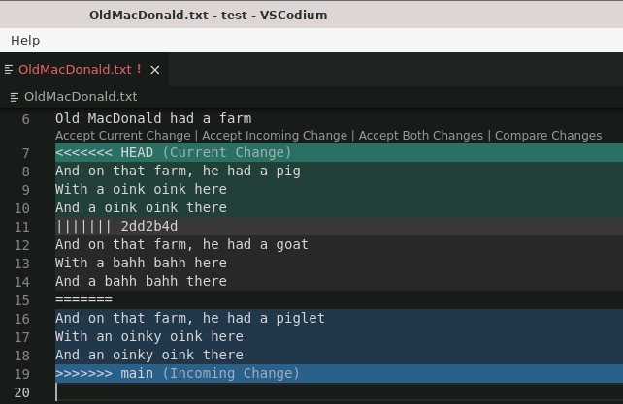
Merge: Raw Merge Conflict Information
Feature
Branch
“Chevrons”
<<<<<<
>>>>>>
Best Common
Ancestor
main
Branch
Notes:
When a merge operation generates a merge conflict conflict:
- git places text directly into the conflicting files
- to represent the conflict
Ask
- What do you think we are seeing here?
- the three versions of the conflicting content
- the feature branch
- the best common ancestor
- the main branch
The conflict is indicated by
- “Chevrons”
- Aligned V shapes
- Often seen on military uniforms to indicate rank
- also often used for directional road markings.
The other symbols
- ||||||| 2dd2b4d
- the SHA of the best common ancestor
- ======
- just a divider before the main branch.
You can simply edit the file directly in VSCode
- Or in any other editor you want
- Combine the stuff between the chevrons so that it looks the way you want.
- Remove the chevrons
- Save and exit
But that is a little awkward… and seems like a good opportunity for a tool!

Slide 21
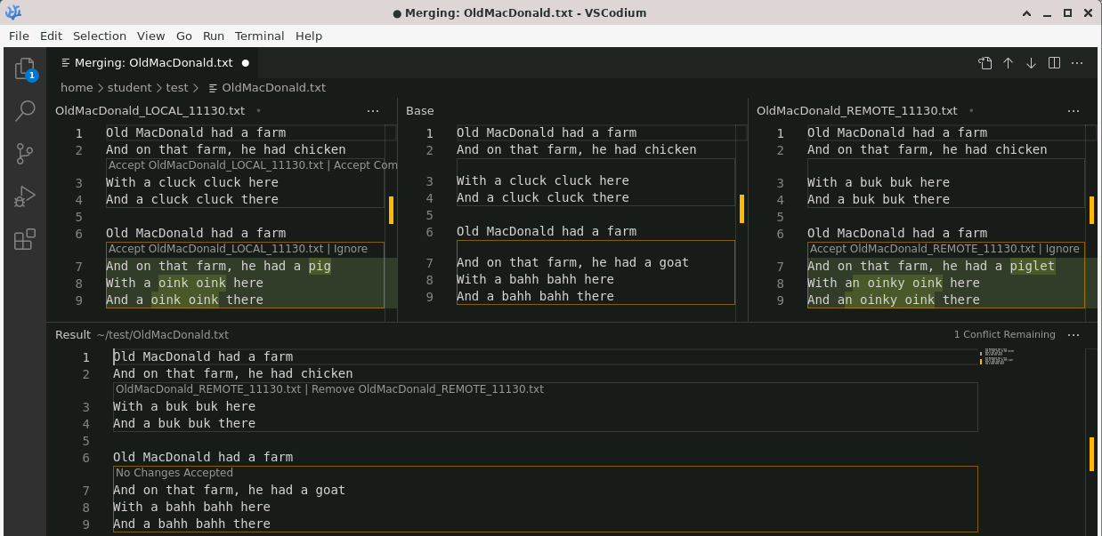

Merge: Using a Graphical Merge Tool
Feature Branch
Best Common Ancestor
Main Branch
Merge Result
Notes:
A graphical merge tool will display the same information as in the raw conflict information,
But it will display it In a way that makes it a easier to work with (once you know what you are doing).
This slide shows the VSCode/VSCodium graphical merge tool.
- This is the one you will use in the activites.
- But most development tools (e.g. Eclipse, NetBeans, etc) will have their own version.
This merge tool has 4 panes.
- The three panes across the top show exactly the information from the raw merge conflict information.
- This is also the information that was in the 3 yellow boxes on the earlier slides
- The contents of the Feature Branch (left)
- The contents of the Main Branch (right)
- The contents of the Best Common Ancestor (center).
- The wide pane at the bottom shows the current result of the merge operation.
VSCode/VSCodium use slightly different terminology for these panes…
- Feature Branch -> LOCAL
- Best Common Ancestor -> Base
- Main Branch -> REMOTE
- Merge Result -> Result
You can also see:
- The non-conflicting changes – outlined in blue (on the slide – not by VSCode)
- The conflicting changes – outlined in reg (on the slide – not by VSCode)
- Though VSCode does highlight the conflicting changes in yellow.
You can also see that the non-conflicting changes are automatically accepted into the Merge Result.
- But the conflicting changes are not!

Slide 22
Merge: Using a Graphical Merge Tool
Feature Branch
Best Common Ancestor
Main Branch
Merge Result
Notes:
To help with resolving merge conflicts the graphical merge tool provides some helpful point-and-click operations.
Clicking one of the “Accept” lines will copy that change into the Merge Result
- For example, clicking “Accept … LOCAL” above the “cluck cluck” lines
- Replaces the ”buk buk” lines in the result with the “cluck cluck” lines.
- Similarly, clicking the “Remove…REMOTE” line above the “buk buk” lines in the Merge Result
- Removes the “buk buk” lines from the result and replaces them with the “cluck cluck” lines.
Similar options exist for the conflicting changes.
- Clicking the “Accept … LOCAL” above the “pig” lines will place them into the result in place of the “goat” lines.
- Or clicking the “Accept … REMOTE” above the “piglet” lines will place them into the result in place of the “goat” lines.
The options available for “Accept” and “Remove” will change based on what has been accepted or removed.
- For example, if the “LOCAL” “pig” changes are accepted then
- The option to ”Accept ... LOCAL” for those changes will disappear and
- An option to “Remove … LOCAL” will appear in the Result.

Slide 23
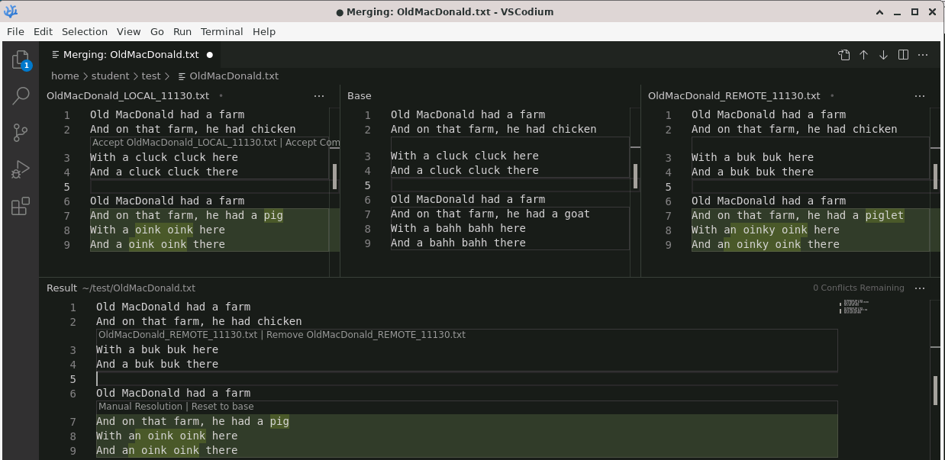

Merge: Using a Graphical Merge Tool
Feature Branch
Best Common Ancestor
Main Branch
Merge Result
Notes:
Here the merge conflict has been resolved by:
- Accepting the LOCAL (feature branch changes
- Then manually editing them to use “an” instead of “a”
Notice that the actions in the Merge Result have changed
- it now indicates that the the merge has had a “Manual Resolution”
- (i.e. parts of it were edited directly)
- And it offers an option to “Revert to base”
- which would change it back to the “goat” lines from the Best Common Ancestor.
Now that we have the Merge Result looking like we want it to…
- Save the result
- Close the merge tool
- Stage and commit the changes
- Push them to the origin to update the Pull Request.

Slide 24
Big Picture: Resolving a Merge Conflict
1. switch to feature branch
2. merge main branch
3. resolve conflict
4. stage changes
5. commit changes
Notes:
Here we just have it all together.
- At this point the local and origin have already synchronized with the upstream.
- The process is:
- Switch to the feature branch (if it is not already the active branch)
- Merge the main and feature branches (sources) into the feature (target) branch.
- Use the merge tool to resolve the conflict.
- This will make changes to the local files that need to be committed and pushed!
- Stage the changes
- Commit the changes
- Push the feature branch to the origin
- recall that this will automatically update the PR
- Once the changes are pushed your PR will be able to be merged automatically!
This is where you will want to get to by the end of the activities for this topic.

Slide 25
Big Picture: Whole Messy Thing
Notes:
No need to spend much time here.
If you can look at this and remember
- what each of the yellow terms means
- how it relates to the others
- sequence them into a workflow
Then you are in good shape.
- if not keep this handy
- review a little
- make more sense of it little by little.

Slide 26

Acknowledgments:
Slide Template From:
https://creativecommons.org/licenses/by/4.0/
Slide Content Licensed as:
https://creativecommons.org/licenses/by-nc/4.0/

